Slide 1

Week 7
More Files

Slide 2
Menu
Binary Files

Slide 3
Binary Storage Review
Review:
Everything is stored in memory – and on disk – as bits:
Integers: 25₁₀ is stored as:
0000 0000 0000 0000 0000 0000 0001 1001
Floats and Doubles:
Various standards
ex: IEEE 32-bit (float):
1 bit for sign, 8 bits for exponent, 23 bits for mantissa
Boolean:
is actually an integer, 4 bytes, 32 bits
false is 0000 0000 0000 0000 0000 0000 0000 0000
true is anything else

Slide 4
Binary Storage Review
Review:
Everything is stored in memory – and on disk – as bits:
Characters (char or string):
uses local coding to represent characters
In Western world: ASCII code set
See ASCII tables on Blackboard
regular set (first 128 chars)
extended set (second 128 chars, system dependent)
Examples:
'A' is stored as:
65₁₀
0000 0000 0000 0000 0000 0000 0100 0001₂
41₁₆

Slide 5
More review
Text files store the ASCII character value.
Example:
string name = "Waldo";
outfile << name << endl;
The file contains this (in hex):
57 61 6C 64 6F 0D 0A
W a l d o CR LF
Notepad translates to "printable"
File Viewer will show hex codes and "non-printing" characters.
Notepad
Waldo

Slide 6
More Review
OK so far?
Here's where it gets interesting:
int age = 23;
string name = "Waldo";
outfile << name << endl;
outfile << age << endl;
The file contains this (in hex):
57 61 6C 64 6F 0D 0A
W a l d o CR LF
32 33 0D 0A
2 3 CR LF
WRITE
to file
Notepad
Waldo
23

Slide 7
More Review
So what?
The file contains this (in hex):
57 61 6C 64 6F 0D 0A
W a l d o CR LF
32 33 0D 0A
2 3 CR LF
The number 23₁₀ is hex 17₁₆ or binary 0001 0111₂
The stored value is not the number 23, it is the string "23"
Notepad
Waldo
23

Slide 8
More Review
So what?
The number 23₁₀ is hex 17₁₆ or binary 0001 0111₂
The stored value is not the number 23, it is the string "23"
Notepad
Waldo
23

Slide 9
End of Review
If you store numbers in a text file
they are stored as strings
not numbers
When you read the string back in:
You must convert it back to a number
If you need it to be a number
int age = 23;
string name = "Waldo";
string agestring;
getline (infile , name ); // no conversion necessary
getline (infile , age ); // can't do this
getline (infile, agestring); // can do this, as a string
age = atoi(agestring.c_str() ); // convert
READ from file

Slide 10

In Conclusion
Text files are good
Even for storing numbers
As long as you consider data types
Everything is written to a text file as a string.
When you read the file in
If you want numbers (not the string)
You must convert them back to numbers!

Slide 11

Is that it?
There's another option:
Binary files:
Write the values to a file in their native format.
No conversion necessary

Slide 12
Binary Files
Values written to a file directly:
strings and chars write as ASCII characters (readable)
ex: the string "Lyn" is written as 3 bytes:
0100 1101 0111 1001 1010 1110
L y n
int, double, float, bool are written in their native binary form
ex: the int value 377₁₀ is written as 4 bytes:
0000 0000 0000 0000 0000 0001 0111 1001

Slide 13

Binary Files
Non-strings and non-chars are hard to read by humans:
Notepad will likely show "garbage"
This is Good or Bad, depending on who reads them

Slide 14
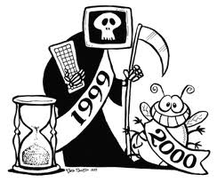
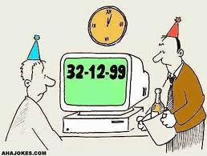
Binary Files
Binary files are a legacy of:
slow processors
slow hard drives
slow I/O interfaces
expensive/scarce memory
Binary is better because:
Faster reads and writes because no conversion
Can control data size by using data types

Slide 15
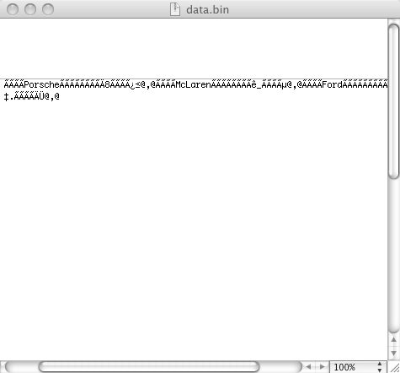
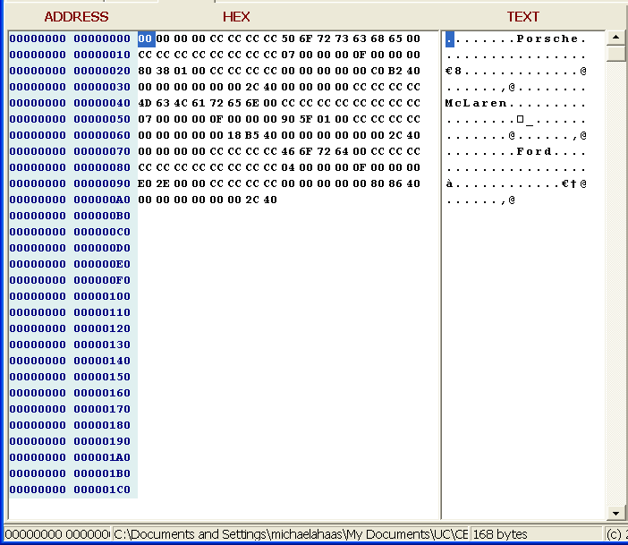
Binary Files
Example:
Text Editor
File Viewer

Slide 16
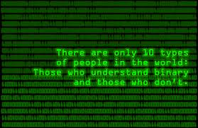
Binary Files
Code Samples:
BinaryFiles.cpp
BinaryFiles2.cpp
Posted on Blackboard

Slide 17
Binary Files
Rules:
You must know the file format:
Types and lengths of variables
Very difficult – and dangerous – to edit binary files outside of your program
You can…but you shouldn't

Slide 18

Binary Files
Be careful of C++ strings
will only output 15 characters to a binary file
see BinaryFiles.cpp on Blackboard
use C-style strings instead
see BinaryFiles2.cpp on Blackboard
Better still:
use text files

Slide 19
Writing to a Binary File
const int items = 10;
int price[ items ];
double tax[ items ];
double shipping[ items ];
// code to supply values to all elements in all arrays
WriteBinaryFile(price, tax, shipping, items); // call
void WriteBinaryFile(int price[], double tax[], double shipping[], int items)
{
int bytestowrite;
ofstream outFile ("c:\\data\\newdata.bin", ofstream::binary); // open file
for (int i = 0; i < items; i++ )
{
bytestowrite = (sizeof (price[i]);
outFile.write (price[i], bytestowrite);
bytestowrite = (sizeof (tax[i]);
outFile.write (tax[i], bytestowrite);
bytestowrite = sizeof (shipping[i]);
outFile.write (shipping[i], bytestowrite);
} // end for
outFile.close();
return;
}
price[0]
tax[0]
shipping[0]
price[1]
tax[1]
shipping[1]

Slide 20
Reading a Binary File
void ReadBinaryFile( int inputarray[])
{
int inputrecord;
int filesize;
int recordnumber;
int inputcount;
// open the binary file
ifstream inFile ("c:\\data\\data.bin", ifstream::binary);
inFile.seekg(0,ifstream::end); // point to end of file
filesize=inFile.tellg(); // get size of file in bytes
// number of records is file size divided by record size
recordnumber = filesize/(sizeof(inputarray[0]));
inFile.seekg(0); // point back to beginning of file (start reading there)
for (inputcount = 0; inputcount < recordnumber; inputcount++) // read the file
{
inFile.read( inputrecord, sizeof(inputarray[inputcount]));
inputarray[inputcount] = inputrecord;
} // end of for loop
inFile.close();
cout << "\n******* Read " << inputcount << " records.\n";
return;
}
Note this
inputarray[0]
inputarray[1]
inputarray[2]
inputarray[3]

Slide 21
Watchouts
You know how much you are going to read
if you used seekg method
So:
You shouldn't have eof() problems
You still need to check for blanks/nulls
Different scenario, but
Same questions:
If blank field/record, do you keep it?
if so, what goes into variable?

Slide 22

Enough!
Done with Binary Files.

Slide 23
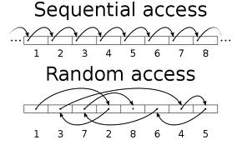
And, there's more
Sequential Access
Random Access

Slide 24
Sequential vs. Random Access
Sequential Access:
starts at the beginning of the file
reads or writes:
a line at a time (text file)
a byte or value at a time (binary file)
until the end of the file
open to read or write:
ofstream class for output
ifstream class for input
Blackboard Examples:
Files++, BinaryFiles, BinaryFiles2, Sequential Files
Here
Here is line 0
Here is line 1
Here is line 2
Here is line 3
Here is line 4
Here is line 5
Here is line 6
Here is line 7
Here is line 8
Here is line 9
Then Here
Then Here
Then Here
Then Here
Then Here
Then Here
Then Here
Then Here
Then Here

Slide 25
Random Access
Can access individual bytes
Output (ofstream) uses:
put pointer (tellp, seekp)
points to position of next write operation
Input (ifstream) uses:
get pointer (tellg, seekp)
points to position of next read operation
Input and Output (fstream)
open a file to read and write
uses both pointers
Then Here
Here is line 0
Here is line 1
Here is line 2
Here is line 3
Here is line 4
Here is line 5
Here is line 6
Here is line 7
Here is line 8
Here is line 9
Then Here
Then Here
Then Here
Here
Then Here
Then Here
Then Here
Then Here
Then Here

Slide 26
Random Access
Sample:
RandomAccess.cpp
Reads a text file
Updates a record
Several challenges:
fixed record size or delimited
Update is easy, but…
it overwrites previous values
Insert
Delete

Slide 27

What do I need to know?
You should know:
What sequential access is
What random access is
You will see these concepts again.
You will not be required to:
write a random access program

Slide 28
The End
Week 7, Part 1

